Slide 1

NAVTTC
ARTIFICIAL INTELLIGENCE | FINAL PROJECT
HirePakistan
AI-Powered Intelligent Job Recommendation Platform
Muhammad Saddique | Course: Artificial Intelligence
Powered by NLP · TF-IDF · Cosine Similarity

Slide 2
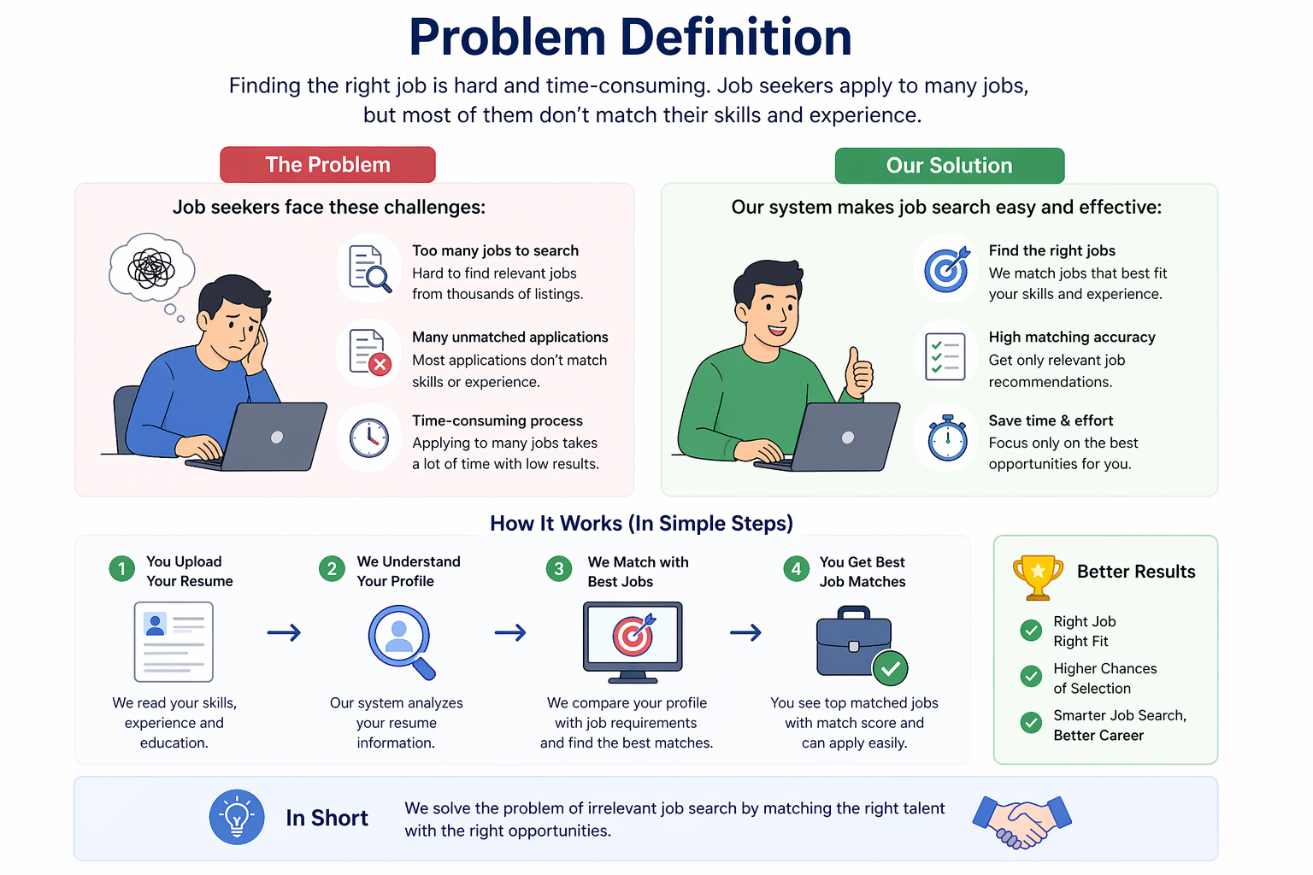

Slide 3

Q1 · Which Dataset is Used?
HirePakistan dynamically generates its own live dataset — no static CSV. A scraping agent collects real-time job listings from 6 major Pakistani portals every 6 hours.
Rozee.pk
Mustakbil
FPSC
Pakistan's #1 private job portal
Leading employment platform
Federal Public Service Commission
KPPSC
SPSC
AJKPSC
KP Public Service Commission
Sindh Public Service Commission
AJK Public Service Commission
Saved to: Pakistan_Jobs_Report.xlsx & SQLite Database (auto-updated every 6 hours)

Slide 4


Q2 · Which Algorithm is Used?
01 TF-IDF Vectorizer
02 Cosine Similarity
03 Heuristic Boosting
Converts resume & job text into mathematical vectors. Rare keywords get higher weight than common words.
Calculates the angle between Resume Vector and Job Vector to produce a semantic match percentage.
+3% matching skills · +10% location match
+15% job title match. Custom logic on top of ML.
Mathematical Formulas
TF-IDF
Cosine Sim
TF(t,d) = (count of t in d) / (total terms in d)
cos(θ) = (A · B) / (|A| × |B|)
IDF(t) = log( N / df(t) ) → TF-IDF = TF × IDF
Score = Σ(AᵢBᵢ) / √Σ(Aᵢ²) × √Σ(Bᵢ²)

Slide 5





Q3 · What Will be Achieved?
Automated Data Pipeline
AI Resume Parsing
Self-updating job board scraping 6 portals every 6 hours — zero manual data entry required.
Users upload CV/Resume; system auto-extracts skills, employment history, and education.
Smart Recommendations
Complete SaaS Architecture
Shifts from 'user searches jobs' to 'system brings best jobs to user' via AI match scores.
Flask app with user auth, secure file uploads, SQLite database & background scheduler.

Slide 6


Q4 · Project Flow
01
02
03
04
05
Data
Collection
User
Registration
Resume
Parsing
AI
Matching
Ranked
Dashboard
Scraper runs every 6 hrs, visits 6 job portals, updates DB
Job seeker creates account & uploads Resume/CV document
resume_parser.py extracts skills, location & job titles
matcher.py runs TF-IDF + Cosine Similarity on active jobs
Jobs ranked by Match Score (e.g. 94%) with apply links

Slide 7

Thank You!
HirePakistan — Bridging Talent & Opportunity with AI
Muhammad Saddique · AI Course
NAVTTC
HirePakistan · Muhammad Saddique · NAVTTC

